Slide 1
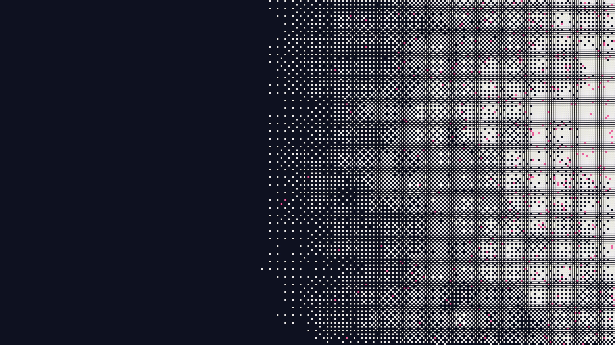

Rand Protocol
Private computation, hash-based proofs
Shielded notes, a RISC-V zkVM proved by a hash-based STARK with no trusted setup, and chained HotStuff BFT. For due diligence.
Technical overview · Version 6 · October 2026
Live public test network (chain 20, release v0.6.8, since 1 October 2026). Not a mainnet; all validators are run by the core team.

Slide 2

OVERVIEW
Rand makes privacy the default and proves every transaction with hash-based STARKs
A layer-1 chain whose transactions are zero-knowledge proofs; live as a public test network (chain 20) since 1 October 2026.
Private by default
Value exists only as notes in a shielded pool, with no accounts or balances. A transfer publishes nullifiers and commitments, not sender, recipient or amount. Cost: fees, timing and bridge amounts stay public.
General programs, private inputs
A RISC-V (RV32IM) zkVM runs programs off-chain; the chain checks the proof and eight public output words. A transfer is such a program too, with a small auth proof. Cost: calls are limited to tier 14, a size class of under 16,383 cycles (slide 6).
Hash-based proofs
A Plonky3 batch STARK over the Goldilocks field with FRI and Poseidon2: hashes and field arithmetic, with no elliptic-curve or pairing assumption in the proof system. Cost: about 1.5 MB per proof, about 2.9 MB per transfer.
No trusted setup
No ceremony and no secret parameters: every verifier key derives from public values. Cost: the proof rules are still changing, and each change so far shipped as a new chain (a hard fork).
Rand Protocol · Technical overview · Version 6 · October 2026 · Not an offer · For discussion
2

Slide 3
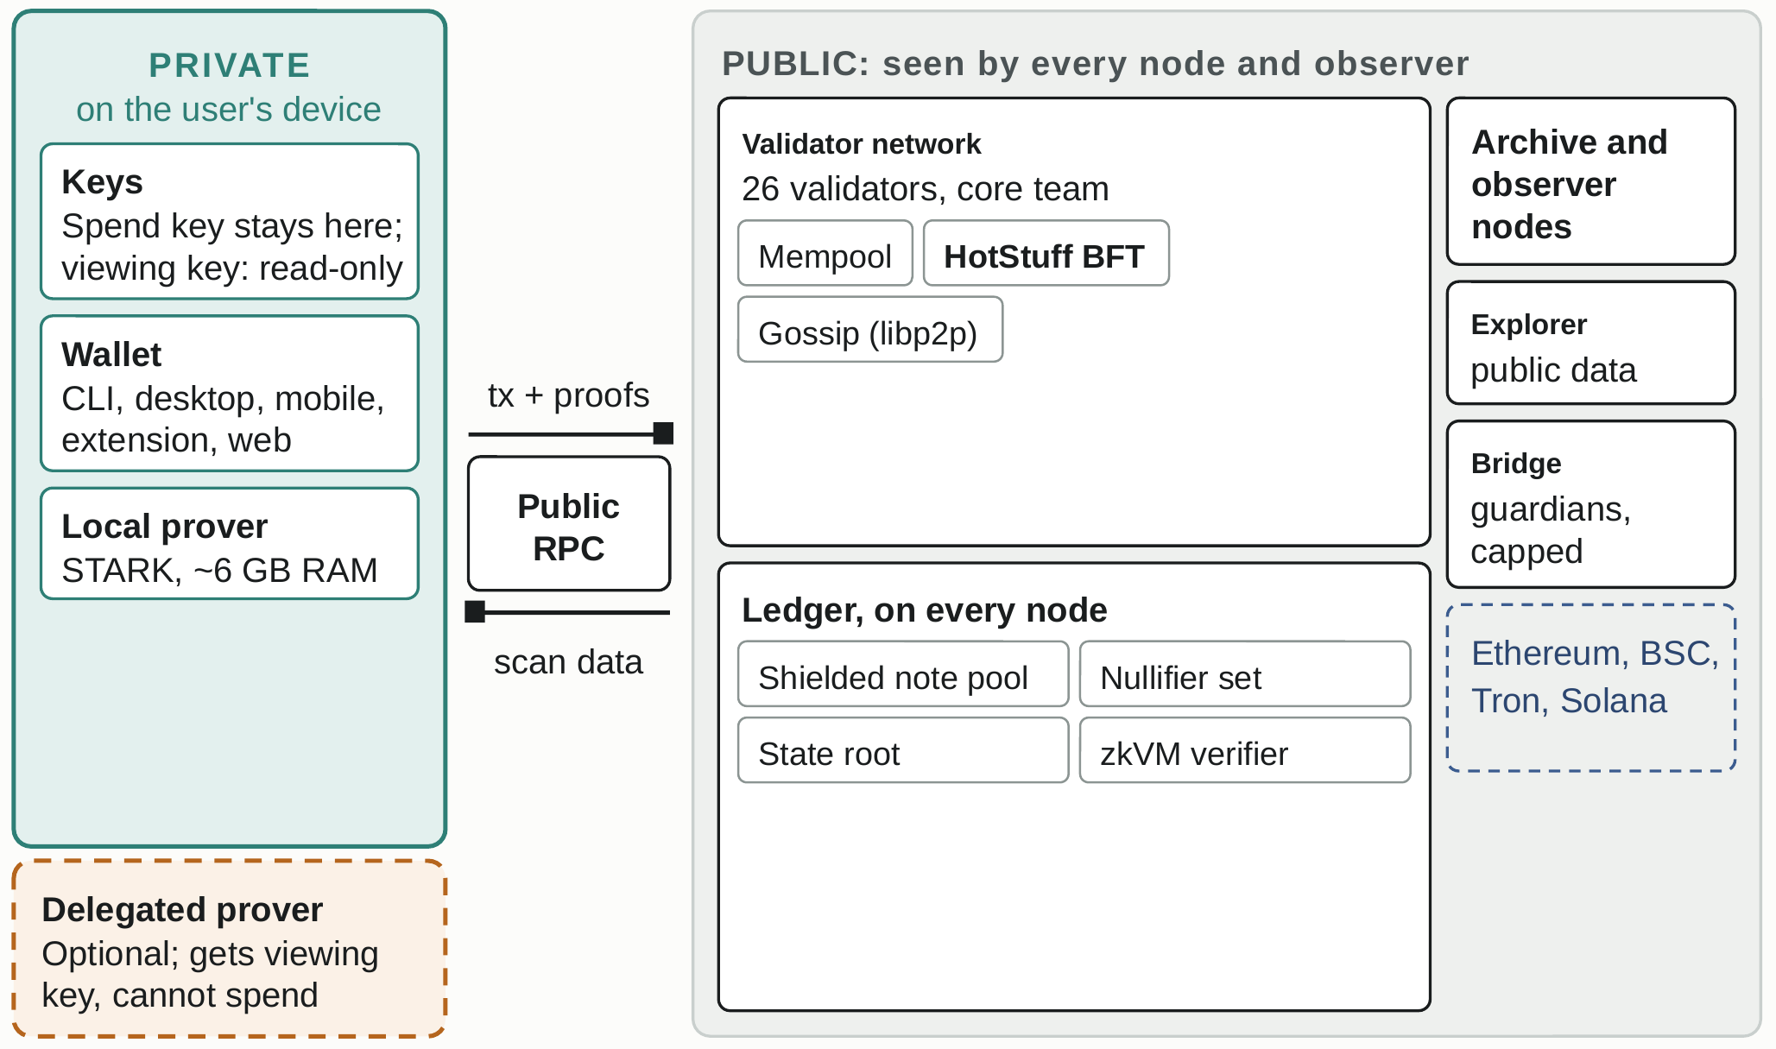
SYSTEM
Private work happens on the user's device; the public network only verifies proofs
READING THE DIAGRAM
The spend key never leaves the wallet; an optional delegated prover (slide 16) gets the viewing key and cannot spend.
The RPC passes proofs to the mempool; HotStuff BFT orders them; every node verifies each proof.
All 26 validators are run by the core team today.
A capped guardian bridge links to Ethereum, BSC, Tron and Solana; the core team runs it, administrator keys included.
Observers feed the explorer, a public index of chain data.
Teal: on the user's device. Grey: visible to every node and observer. Chain 20, 1 October 2026; 6 GB peak measured on one laptop.
Rand Protocol · Technical overview · Version 6 · October 2026 · Not an offer · For discussion
3

Slide 4
PRIVACY
The ledger hides owner, amount and the note a spend consumes; fees, timing and bridge amounts stay public
No accounts, balances or nonces exist: value is notes, and a note is only a commitment until its holder spends it.
HIDDEN ON THE LEDGER
PUBLIC, OR VISIBLE TO THE NODE A WALLET USES
Owner, amount and asset of each note: only a Poseidon2 commitment in a depth-32 tree is stored.
Which note a spend consumes: a published nullifier does not link to its commitment without the viewing key.
Sender, recipient and amount: a node's view of a transaction has no from, to, nonce or amount field.
Shape and memos: every bundle has four inputs and four outputs; every note envelope is a fixed 1,860 bytes on chain 20.
Key holders only: the recipient opens amount, asset and the sender's owner field; a viewing key opens a whole history, read-only.
Nullifiers, which stop double spends, and note commitments, which feed the tree.
The fee, whose floor differs by action: a transfer differs from a program deploy or call.
Submission timing, and the network address of a wallet that submits or scans.
Merkle paths: a node that serves them sees which note a wallet spends; the command-line wallet computes them locally.
Bridge amounts, the validator register and stake bonds, program code, and program payouts (recipient, amount).
A call proof's header: its tier and, roughly, whether the hash tables were used.
Rand Protocol · Technical overview · Version 6 · October 2026 · Not an offer · For discussion
4

Slide 5
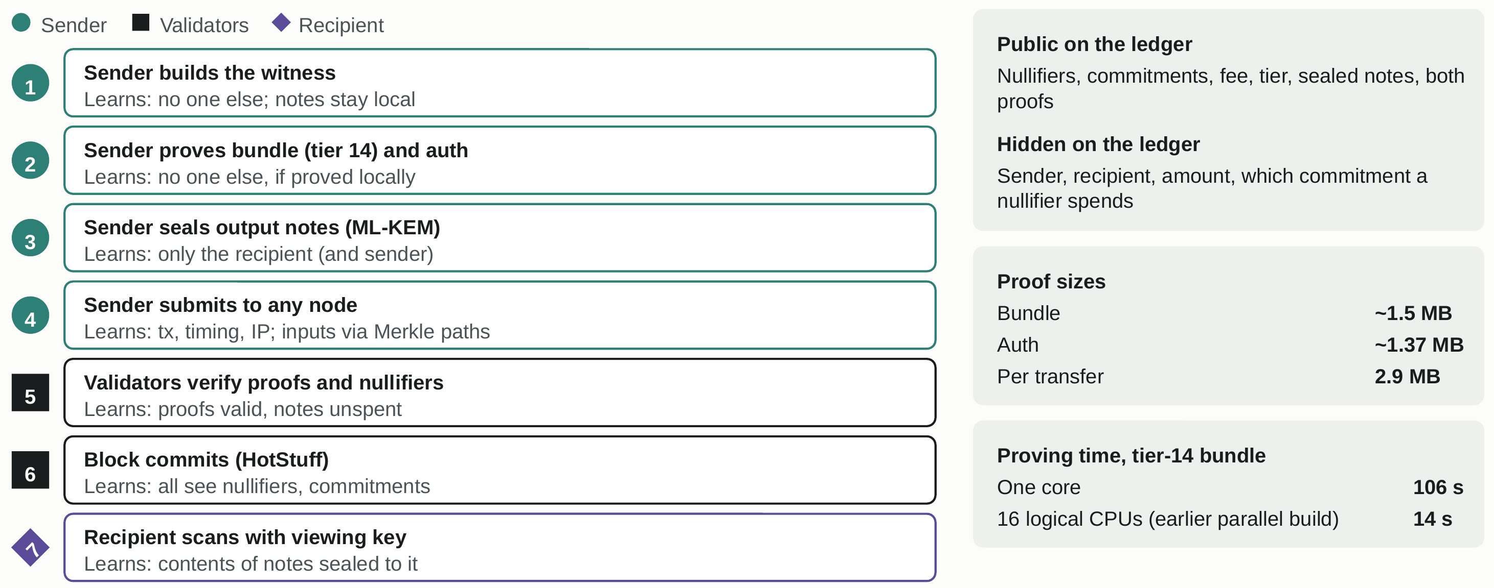
A PRIVATE TRANSFER
The sender proves a private transfer before submitting it; every validator then checks it
Hidden means hidden on the ledger. Times measured on one 16-core laptop-class machine, not optimised; the 14 s figure is from an earlier parallel build.
Rand Protocol · Technical overview · Version 6 · October 2026 · Not an offer · For discussion
5

Slide 6
THE ZKVM
The zkVM proves RISC-V programs in padded tiers, so cost follows the tier and not the cycles used
Chain 20 settings, live public test network, 1 October 2026.
Guests. A guest is an RV32IM program (32-bit RISC-V with integer multiply and divide). Its identity is a Poseidon2 digest computed inside the proof; a run ends in eight public output words.
Tiers. Execution is padded to a tier t, from 10 to 20 in steps of 2, which allows up to 2^t − 1 cycles. The proof shows t, not the number of cycles used.
Two proofs per transfer. The bundle guest (tier 14, four inputs and four outputs) and a small auth guest (tier 10), which is the only proof that carries the spend key.
Calls. Calls to deployed programs are limited to tier 14 today (under 16,383 cycles, digest rows included), so only small programs are admitted.
Constraint sets. The proof rules are versioned. Set 8 runs on chains 18 to 20; each of seven changes in September 2026 needed a new chain.
TIERS · MAX CYCLES
TIER | MAX CYCLES | USED BY
10 | 1,023 | Auth guest
12 | 4,095
14 | 16,383 | Bundle guest; today's call cap
16 | 65,535
18 | 262,143
20 | 1,048,575
Why padded tiers
Padding hides how much work a run did: the proof shows only its tier. A short program pays for its whole tier.
Rand Protocol · Technical overview · Version 6 · October 2026 · Not an offer · For discussion
6

Slide 7
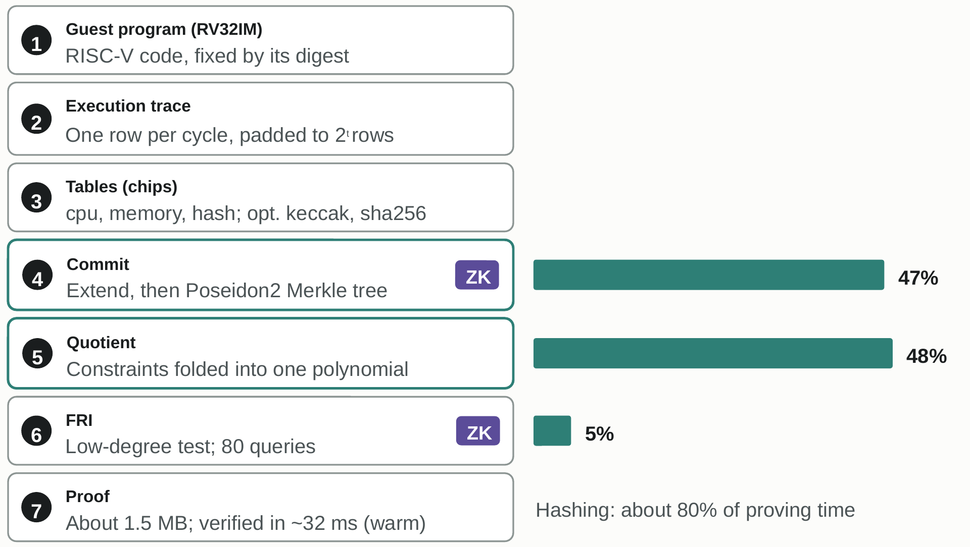
PROOF SYSTEM
Transparent STARK proofs need no trusted setup, at the cost of megabyte-sized proofs
GIVES, AND DOES NOT GIVE
Gives: no trusted setup; hashes and field arithmetic only; verifier keys derive from public values.
Gives: zero knowledge from salted, hiding commitments; a warm check of about 32 ms per proof.
Does not give: perfect zero knowledge. It is statistical; each proof shows its tier and table heights.
Does not give: small proofs. About 1.5 MB each, set by 80 queries and trace width.
FRI stage, classical: about 86 bits proven (66 from queries, 20 grinding), about 100 conjectured. No overall level is claimed.
Plonky3 0.7.0, Goldilocks, blowup 8, 80 queries, 20 grinding bits, Poseidon2. Bars: share of one-core proving time of a tier-14 bundle, one 16-core laptop-class machine, not optimised.
Rand Protocol · Technical overview · Version 6 · October 2026 · Not an offer · For discussion
7

Slide 8
MEASURED COST
A proof takes seconds to minutes to make, is about 1.5 MB and takes about 32 ms to verify
Measured on one 16-core laptop-class machine, not optimised. Parallel row: earlier build that could stall (1 run in 20), not re-measured.
MEASURE | BUNDLE PROOF (TIER 14) | AUTH PROOF (TIER 10) | ONE TRANSFER (BOTH)
Proof size | 1.50 MB | 1.37 MB | about 2.9 MB
Prove, one core | 106 s | 6.8 s | about 113 s
Prove, parallel prover, 16 logical CPUs (earlier build) | 13.9 s | about 1.3 s | about 15 s
Peak prover memory, one core | 5.98 GB | 0.39 GB | not summed
Verify, warm key | about 32 ms | about 29 ms | about 61 ms (sum)
Verify, first use (key build) | 4.5 s one core, 1.5 s parallel | 0.33 s | once per node start
Earlier records (8-vCPU cloud machine, older prover and constraint sets; not comparable) | 217–237 s single-threaded, 69–73 s parallel | n/a | n/a
GPU proving | Design, not yet active; no GPU time measured | n/a | n/a
Rand Protocol · Technical overview · Version 6 · October 2026 · Not an offer · For discussion
8

Slide 9
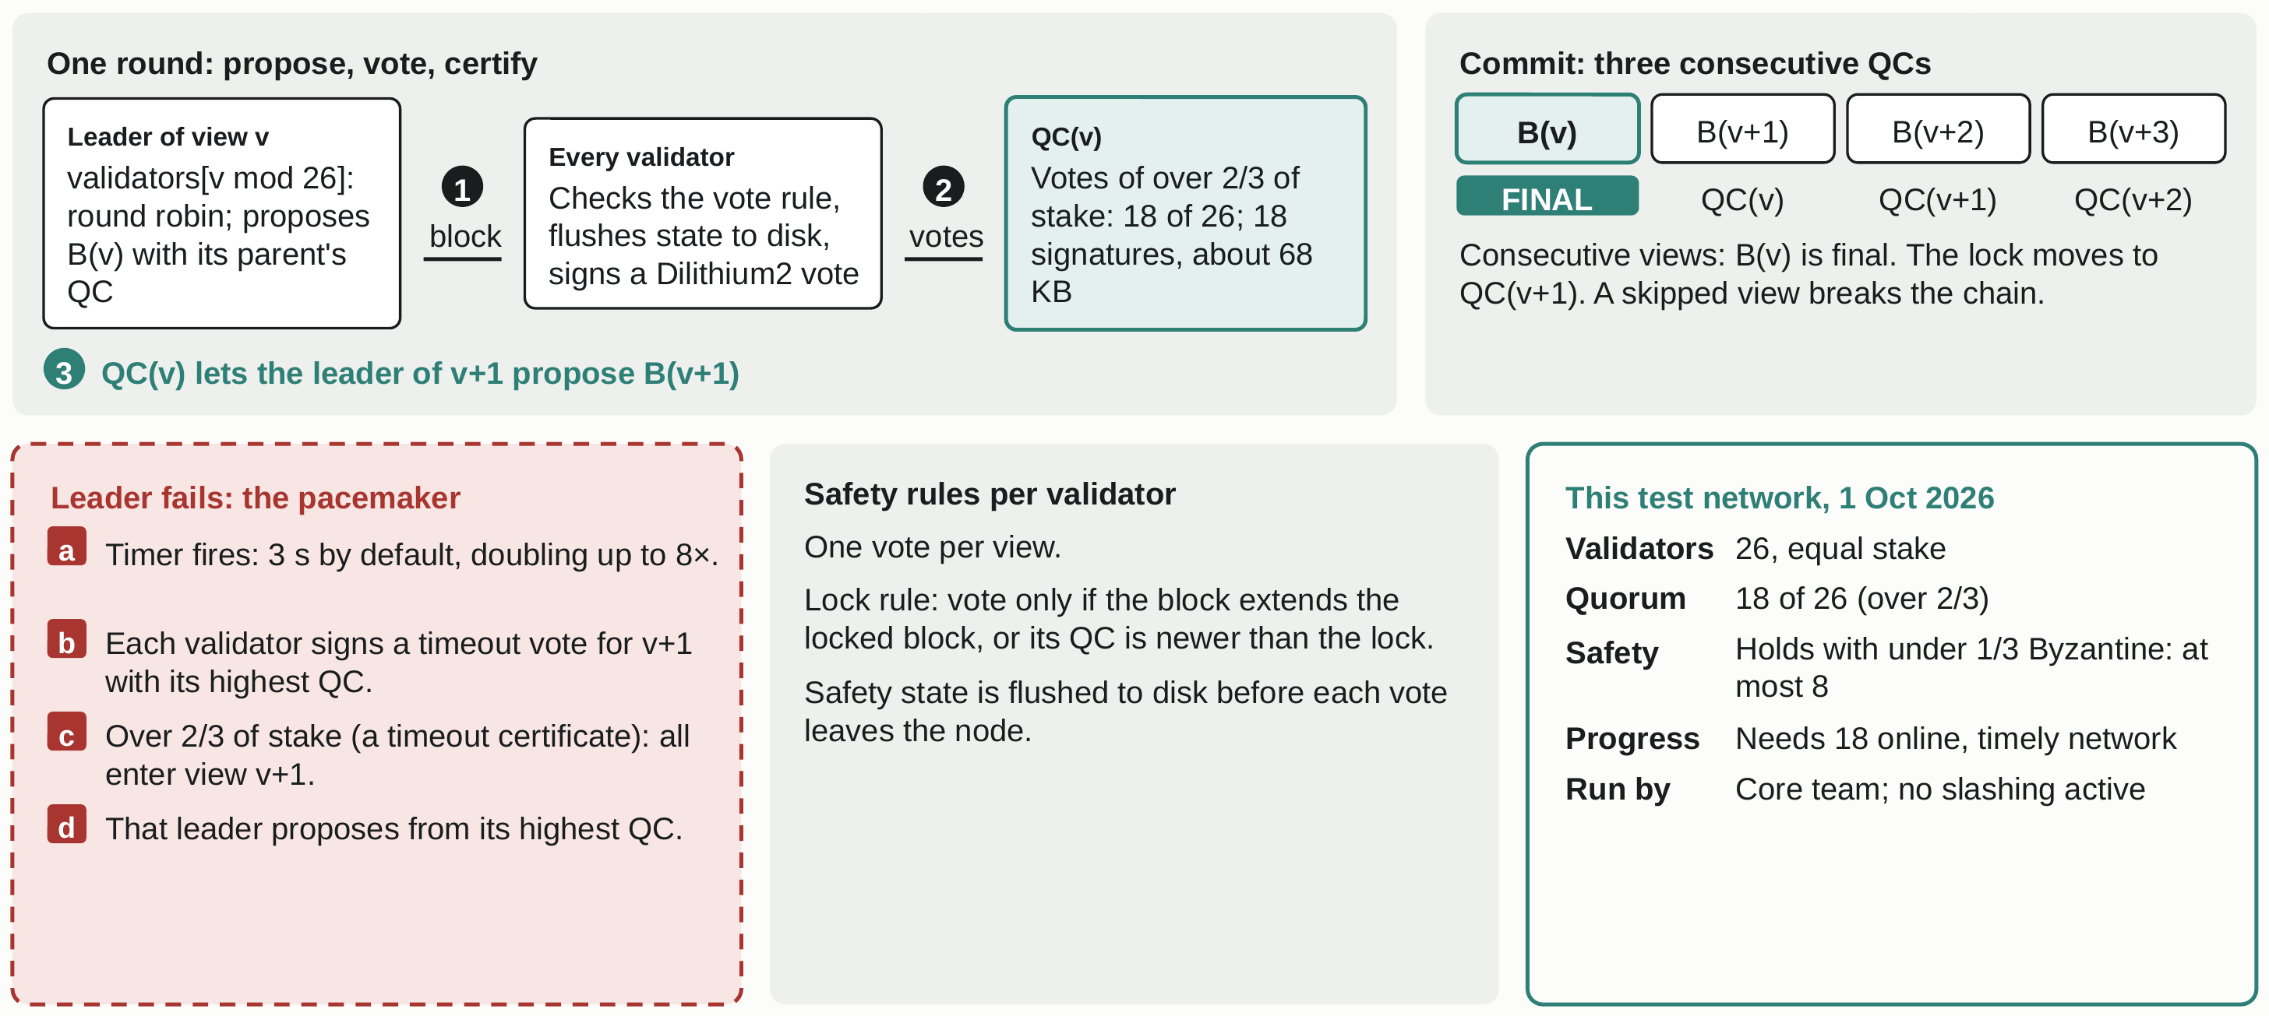
CONSENSUS
Consensus is chained HotStuff: stake-weighted votes, a three-chain commit and a timeout pacemaker
Rand Protocol · Technical overview · Version 6 · October 2026 · Not an offer · For discussion
9

Slide 10
VALIDATORS
The core team runs all 26 validators today; the code supports an epoch register, admission votes and slashing
TRUE TODAY (CHAIN 20, 1 OCTOBER 2026)
WHAT THE CODE SUPPORTS
26 validators of equal stake, all run by the core team. A quorum is 18 of 26, so the core team alone can finalise any block.
The fault bound (under one third Byzantine stake) holds only through the core team's custody of all 26 keys.
New validators need a signed vote of more than two thirds of the current set: the register is permissioned in practice.
Slashing is off on chain 20: a misbehaving validator loses no stake; the remedy is operator action.
No date is given for a wider set; slashing is advised only once stake is held by more than one operator.
A public validator register. Each epoch of 1,000 blocks recomputes the set from it: up to 100 validators, sorted by address.
Stake is bonded by burning notes; new weight activates two epochs later and unbonding takes two epochs.
Weight caps: one third per validator; new weight entering at an epoch boundary is capped at 25 per cent of active weight.
A leader's second block for one view is refused; slashing and jailing for it exist behind a genesis switch, off today.
Leaders rotate round robin in address order. A sortition beacon is a research direction, not built.
Rand Protocol · Technical overview · Version 6 · October 2026 · Not an offer · For discussion
10

Slide 11
THE NODE
Nodes gossip over libp2p, verify every proof themselves and keep consensus state in one hashed root
Network
libp2p 0.57 over TCP with Noise and Yamux. Gossipsub topics per chain for consensus, transactions, status and peer bindings; Kademlia discovery from a bootstrap list. Connections, gossip rates and the mempool have configured limits.
Verification and sync
Cheap checks come first (size, anchor window, nullifiers); proofs are verified last, on 4 workers. A lagging node fetches up to 100 blocks with their certificates and re-executes them, proofs included.
Consensus state
Commitment-tree frontier, nullifier set, validator register and program set, plus genesis-gated sections, under one BLAKE3 state root. The pool's leaves sit in node storage, outside consensus state.
Roles and history
Validator, observer, archive or public RPC front. RocksDB with one fsynced batch per block. Most test-network validators keep one day of blocks and two archives keep all (chain 18 record).
Rand Protocol · Technical overview · Version 6 · October 2026 · Not an offer · For discussion
11

Slide 12
CAPACITY
By the block cap, proof size limits a block to about seven transfers; no sustained-load test exists
Chain 20 settings, 1 October 2026. Derived ceilings; proof times and 32 ms measured on one 16-core laptop-class machine, not optimised.
QUANTITY | VALUE | BASIS
Bytes per transfer | Bundle 1.50 MB + auth 1.37 MB = about 2.9 MB; rest about 8 KB | Measured (proofs); derived (rest)
Block cap, proof cap | 20 MiB per block, 4 MiB per proof | Chain 20 genesis (testnet settings)
Transfers per full block | About 7 (20,971,520 / 2,869,328 = 7.3) | Derived
Transfer ceiling | Arithmetic, not a measured rate: about 5 to 7 per second (1 s minimum spacing; 1.2–1.4 s recorded on chains 14 and 18, none for 20). Every node must receive 20 MiB a block; bandwidth untested | Derived, not measured
Verifying a full block | 14 proofs × 32 ms = about 0.45 s | Derived; not the limit
Proving one transfer | About 15 s, parallel prover on 16 logical CPUs (earlier build, not re-measured) | Measured; done by senders, in parallel
Data if every block were full | About 1.5 TB per day at about 1.2 s a block (1.8 TB at 1 s) | Derived; why pruning matters
Design target | Block-level aggregation: not active, and not yet feasible at scale on the memory measured | Specified; see next slide
Rand Protocol · Technical overview · Version 6 · October 2026 · Not an offer · For discussion
12

Slide 13
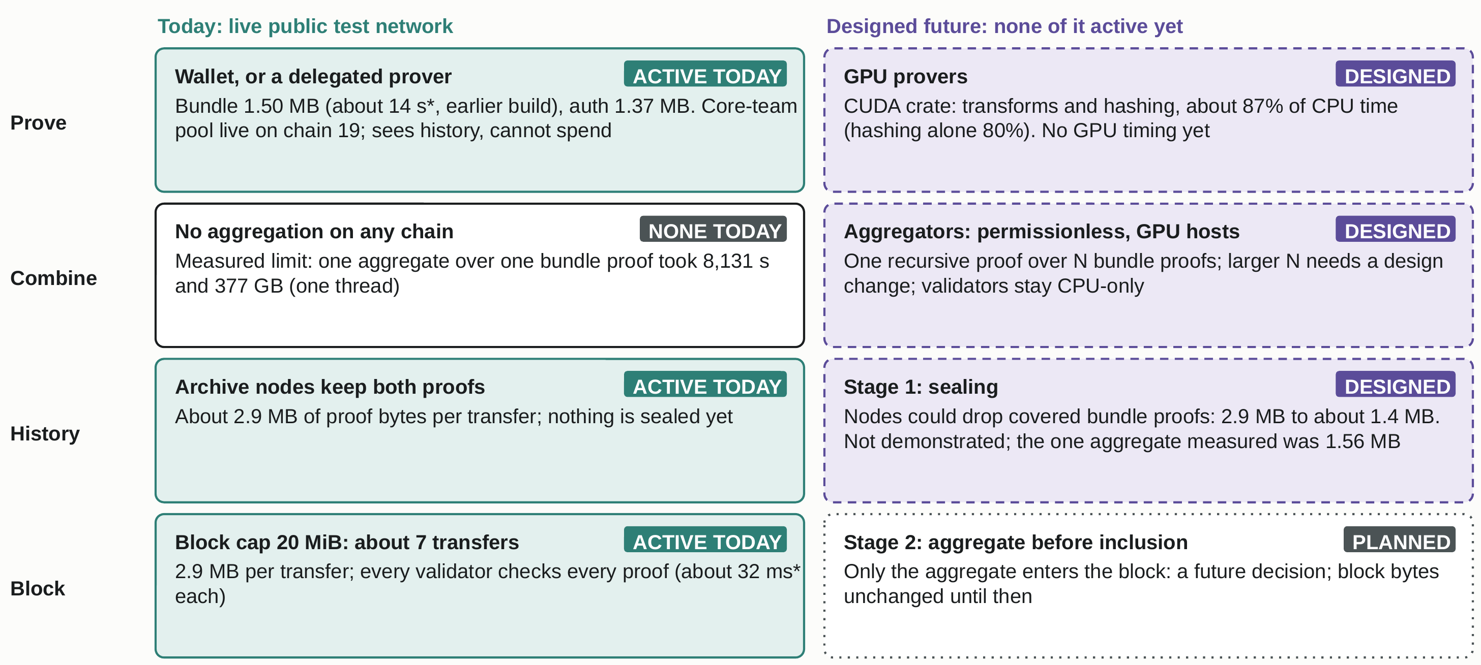
SCALING PATH
The scaling path is designed, not active: proof bytes bound a block today and aggregation is off
* Measured on one 16-core laptop-class machine, not optimised.
Rand Protocol · Technical overview · Version 6 · October 2026 · Not an offer · For discussion
13

Slide 14
PROGRAMS
Programs, translators and the token standard are technical capabilities of the zkVM and the ledger
Capabilities on chain 20, the public test network, as recorded on 1 October 2026.
CAPABILITY | HOW IT WORKS | STATUS
Programs | RV32 code deployed once and named by its content hash. The caller runs it privately and proves the run; the chain stores the proof and eight public output words. Calls are limited to tier 14 (under 16,383 cycles). | Implemented
Programs with state (Invoke, RPL-2) | Public cells and value vaults per program. An Invoke carries a declared state change and the proof of the run (at most 8 reads, 8 writes, 4 payouts). A completed run is accepted: a program must refuse what it forbids. | New in v0.6.8. Enabled in chain 20's genesis; early, no program recorded in use
Translators (EVM and Solana bytecode) | Two off-chain tools turn a contract into an RV32 image; the chain sees only the image and its hash. A translated ERC-20 was deployed and called on an earlier test chain. | Partial. Calls above tier 14 are refused, so translated token calls are not admissible today
RPL token standard | A registry entry, not a contract. Tokens move as shielded notes in the same pool as the native coin RAND. Mint authority is set at registration: none, one key (can hand it on or renounce it) or, since v0.6.8, a program. | Implemented
Rand Protocol · Technical overview · Version 6 · October 2026 · Not an offer · For discussion
14

Slide 15
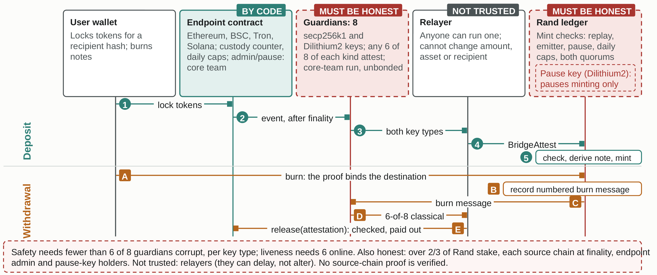
BRIDGE
The bridge trusts a core-team guardian committee: any 6 of 8 can attest a mint, and daily caps limit exposure
As of 1 October 2026.
Rand Protocol · Technical overview · Version 6 · October 2026 · Not an offer · For discussion
15

Slide 16
WALLETS
Wallets keep the spend key on the device; a prover is used only when the device cannot hold the proof
Design of each client. At the chain 20 cut only the command-line wallet could send; app, extension and web builds follow the node release.
CLIENT | BUNDLE PROOF (~1.5 MB) | SPEND KEY AND AUTH PROOF | SHARED WITH A PROVER
Command-line wallet | On the device, or a paired prover | On the device | Viewing key and salt, only if the user opts in to a prover
Desktop app (Windows, macOS, Linux) | On the device (~6 GB peak, one laptop-class machine); can prove for the user's other devices | On the device | Nothing, unless a prover is paired
iOS and Android | On a device with ~8 GB of memory, otherwise a paired prover | On the device | Viewing key and salt, if a prover is paired
Browser extensions and web wallet | A paired prover: WebAssembly memory is capped at 4 GB | On the device | Viewing key and salt, on every send
Core-team prover pool (chain 19 record) | Viewing-key jobs only, no fee, one job per member at a time; the wallet verifies every proof | Never receives the spend key | Operators can read the history of any wallet using it: a trusted third party for privacy
Rand Protocol · Technical overview · Version 6 · October 2026 · Not an offer · For discussion
16

Slide 17
THREAT MODEL
Each property rests on a stated assumption; the heaviest today are one operator and one committee
Threat model from the project's papers: classical and quantum attackers, under 1/3 of stake Byzantine, partial synchrony.
PROPERTY | DESIGN BASIS AND ASSUMPTION | LIMIT STATED IN THE PROJECT'S DOCUMENTS
No conflicting commits | Quorum over 2/3 of stake, three-chain commit, one vote per view, persisted lock; under 1/3 Byzantine | On chain 20 one operator, the core team, holds all 26 keys and slashing is off; the safety argument is on paper
Progress | Rotating leaders, timeout certificates; over 2/3 of stake online | Assumes messages arrive; connection exhaustion is outside the argument. Leaders are predictable and the mempool is plaintext, so the leader orders
Soundness and quantum margin | Hash-based STARK, hiding FRI, no trusted setup; Dilithium2 and ML-KEM-768. Elliptic curves only in peer transport and source-chain contracts | FRI, classical: ~86 bits proven (66 queries, 20 grinding), ~100 conjectured. Quantum, by the project's analysis: ~43 proven, 50 conjectured; transcript hash ~85. No overall level is claimed
Note privacy | Hiding commitments, fixed 4-in, 4-out shape, ML-KEM-768 envelopes; statistical zero knowledge | Fees, timing, nullifiers, proof tier, deposit and burn amounts, program code and payouts are public; a node serving Merkle paths sees the note spent
No double spend or replay | Nullifier set; transactions and proofs bound to the chain id and, on chain 20, the genesis hash | Chains 14 to 19 bound the chain id only; bridge messages have their own replay rules (slide 15)
Bridge | Any 6 of 8 guardians in both signature sets, replay floors, custody counters, a pause key | A corrupt quorum could mint, undetected; releases stay classical; admin and pause roles are core-team accounts
Rand Protocol · Technical overview · Version 6 · October 2026 · Not an offer · For discussion
17

Slide 18
STATE
State on 1 October 2026: a live test network; aggregation and GPU proving are designed, not active
From the project's release records of 1 October 2026; directions are stated by the project and carry no dates.
AREA | IMPLEMENTED | DESIGNED, NOT YET ACTIVE | STATED DIRECTION
Network | Chain 20, live since 1 October 2026; chains 14 to 19 were test chains; each hard fork so far started a new chain | None | A main network, later, with a fresh genesis
Consensus | HotStuff-style BFT; 26 equal-stake validators, all run by the core team; quorum 18 | Slashing for leader equivocation: in code, off on chain 20 | A wider validator set; more slashing; a leader beacon
Proving | 80-query FRI profile, parallel CPU prover (patched, not re-measured), split authorisation, core-team prover pool (chain 19 record) | Block aggregation; a CUDA backend crate; sealing of covered proofs | An aggregator machine class; GPU measurement
Programs | zkVM programs, token registry, program state and Invoke (new in v0.6.8, early) | None | Cross-program calls; block context for programs
Bridge | Four source chains, 8 guardians, small caps; round trip exercised on chain 19 on 1 October 2026 | None | Distinct guardian operators; timelock control; later, a STARK proof of source-chain consensus
Clients | Wallets for CLI, desktop, iOS, Android, browser and web; at the chain-20 cut only the CLI carried v0.6.8 | A CI release workflow with provenance attestation | Rebuilt wallet apps; store listings; more public RPC endpoints
Rand Protocol · Technical overview · Version 6 · October 2026 · Not an offer · For discussion
18

Slide 19
CLOSE
Rand runs on a public test network, limits stated
SUMMARY
Shielded notes, a RISC-V zkVM and a hash-based STARK with no trusted setup, finalised by HotStuff-style consensus, on a live public test network (chain 20, 1 October 2026).
TRADE-OFFS
About 2.9 MB of proofs per transfer bounds a 20 MiB block to about seven transfers; the core team runs all 26 validators and the bridge's guardian committee.
NOT YET ACTIVE
Block aggregation and GPU proving. Directions, without dates: a wider validator set, bridge decentralisation, a main network.
TO DISCUSS
1
From one operator to a wider validator set, and what must hold before slashing is enabled.
2
How proof size falls (aggregation memory limit, sealed history, the auth proof) and what that does to block capacity.
3
Reducing bridge trust: from guardian operators and key hardware to proof-based verification of source-chain consensus.
A technical description of technology under development on a public test network; not an offer or solicitation of any security, token or financial product, and not investment advice. Directions may change; figures are not guarantees.
Rand Protocol · Technical overview · Version 6 · October 2026 · Not an offer · For discussion
19

